Slide 1
Green Process

Slide 2
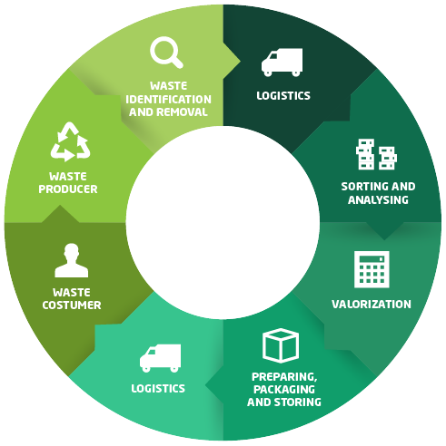

Slide 3

INTRODUCTION:-
A green process refers to the specific actions that allow reducing the environmental impacts among all the processes involved in the manufacture activities of a product.

Slide 4
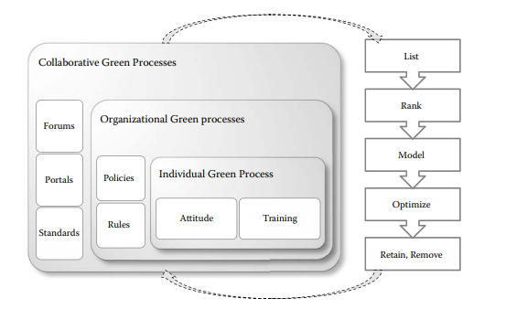
Green Processes: Individual, Organizational, and Collaborative:-

Slide 5
Reengineering of business process to reduce their carbon contents has to happen at three levels: individual, organizational, and collaborative.
These levels tend to be increasingly strategic, taking longer time and greater effort as the business movesfrom individual processes through to departmental- and organizational-level processes.

Slide 6
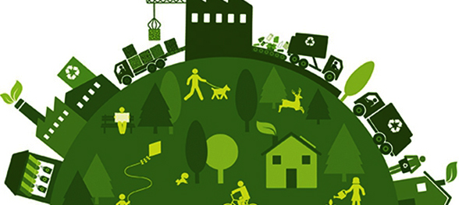
Modeling and optimization of the collaborative processes requires more time and effort and include more players and multiple systems.

Slide 7
Modeling and optimizing core processes from a carbon perspective has higher risks than peripheral.
The core and the peripheral or supporting processes need to be modeled, measured, and optimized from their carbon perspective.
Therefore, each step within the process has to be studied before it is changed or eliminated.

Slide 8
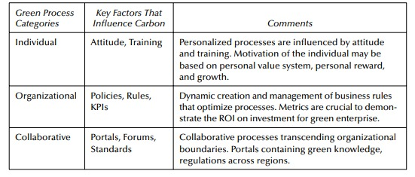

Slide 9
Summarizes the types of processes and also lists the key factors that are important in handling the carbon aspect of these processes. Processes can vary widely depending on their importance, their technology support and the end-goals they achieve for the organization.
Furthermore, the business rules embedded within the business processes also need to be addressed in Green BPR.

Slide 10
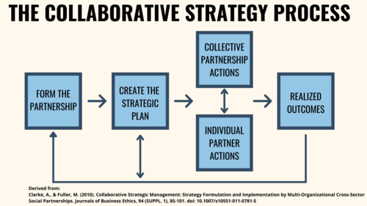
The manner in which the rule is implemented can be optimized by modeling, studying, and changing the activities of the process.

Slide 11
During a Green BPR exercise, careful evaluation of all these business processes at individual, organizational, and collaborative levels within the organization needs to be undertaken.
During this e valuation, these processes are listed, ranked (prioritized), modeled, optimized, and eventually, either retained or eliminated.
These steps, as applicable collectively to all processes in the organization.
These steps, in terms of Green BPR, can be further described as follows:-

Slide 12
1] Listing:-
All processes within an organization. This is an initial list, which will be refined as this green transformation exercise proceeds.
2] Ranking:-
This process list can be undertaken based on the carbon criteria.

Slide 13
3] Modeling:-
This process reengineering requires accurate modeling of those processes. If an organization has already undertaken a BPM exercise, process models for all major processes should be available.
4] Optimizing:-
This step is the study of the processes that are modeled from their carbon impact. Thus, each activity within the process model can be studied and the carbon generated within that activity ascertained.

Slide 14
5] Retaining:-
The processes that are modeled and optimized will reduce their carbon contribution. These are the processes that can be retained and placed in a continuously optimized mode.
6] Removing:-
The BPM exercise will also identify processes that are either redundant/duplicated or are so excessively carbon inefficient that they have to be replaced.

